Slide 1
Coherence Prediction on Distributed Shared Memory Machines
Preston Glenn, Jason Ho, Madison Threadgill
Notes:
Today, we will present on Coherence Prediction on Distributed Shared Memory Machines

Slide 2
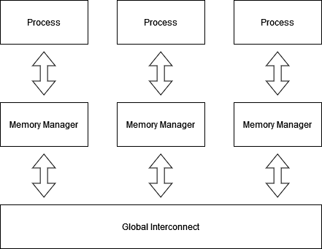
Introduction
Distributed Shared Memory (DSM) Machines
Servers and data center use this paradigm
Shared Memory split between all nodes
Virtual contiguous memory maintained by coherence protocols
Coherency on DSM Machines
Directories at each Main Memory per Node
Global Interconnect to send messages
Incurs network latencies
Notes:
Distributed shared memory machines are found in all types of servers and data centers. Using off the shelf components, many computers are joined together. While there is a virtual contiguous memory, under the hood, it is maintained by directory-based coherence protocols.
Next to each main memory, there are directories which track which nodes have access to blocks of memory. There is a global interconnect that links all nodes, meaning that coherency messages incur network latency.

Slide 3
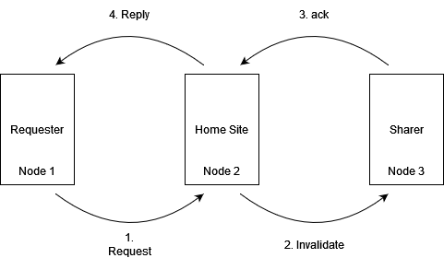
Motivation: Coherence Traffic Example on DSMs
Worst number of unique messages for write permission to a cache line
Notes:
Let’s go back to lab 2. If a remote processor wanted to request a write permission and there was a previous sharer, it would need to send the request to the homesite. Then the homesite would send an invalidation request to the remote sharer, the sharer would need to acknowledge the request and once all sharers
had acknowledged, the home site can finally grant permission to the requester.
Remote access delays are long and the processor can stall, waiting on requests to be fulfilled. This does not even factor in lossy networks, messages sitting in queues, and corrupted data.

Slide 4
Motivation
IDEA: Hide Network Latency through speculation on coherence?
Notes:
How can we speed this up?
One idea is to hide remote access latency through speculation on coherence.

Slide 5
Motivation: Example Walkthrough
Worst number of unique messages for write permission to a cache line
Notes:
Back to our example, let’s consider whether it makes sense to speculate on these message.

Slide 6
Motivation: Example Walkthrough
Worst number of unique messages for write permission to a cache line
Value Speculation (Dangerous and Expensive if Wrong)
Notes:
Speculating replies are dangerous and can leave a line’s coherence in a incoherent state.

Slide 7
Motivation: Example Walkthrough
Worst number of unique messages for write permission to a cache line
Value Speculation (Dangerous and Expensive if Wrong)
Predict Requests? Similar to Prefetcher
Notes:
Predicting requests is similar to prefetching. If we do it at the home site, which has the global accesses and order of accesses on a cache line, we may be able to do better.

Slide 8
Motivation: Example Walkthrough
Worst number of unique messages for write permission to a cache line
Value Speculation (Dangerous and Expensive if Wrong)
Predict Home Site Requests on Processor Lines?
Predict Requests? Similar to Prefetcher
Notes:
What about the last two? Can we predict home site requests at the processor, such as invalidates and shared permission requests?
Let’s try and formalize our taxonomy beyond this example on a MESI protocol transition diagram.

Slide 9
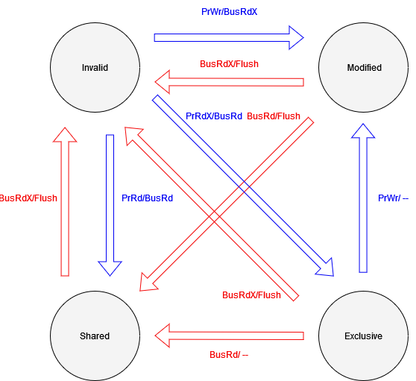
Motivation: MESI Protocol State Transitions
Blue - Processor Actions
Red - Bus Transactions
Notes:
Here, we show all the state transitions of a MESI protocol, but remove the requests that do not generate state transitions. For instance, modified to modified.

Slide 10
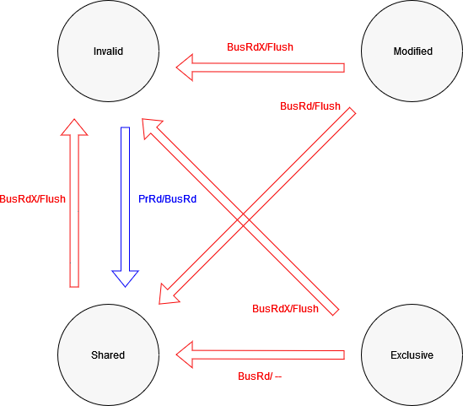
Motivation: MESI Protocol State Transitions
Blue - Processor Actions
Red - Bus Transactions
Notes:
Now, let us get rid of all the processor actions: invalid to modified, invalid to exclusive, and exclusive to modified. Invalid to exclusive or invalid to modified can be scary to predict, as the consequenting invalidations may invalidate lines that are still useful to remote processors. Going from exclusive to modified is a silent promotion.
We can now group the remaining state transitions.

Slide 11
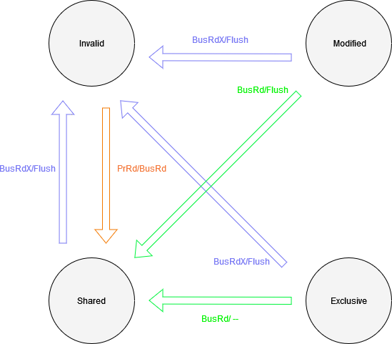
Motivation: MESI Protocol State Transitions
Purple - Bus Write Prediction (Invalidation Prediction)
Orange - Bus Read Prediction (Consumer Prediction)
Green - Shared Permission Prediction
Notes:
Here, the purple and green represent transitions where a processor may need to respond to requests from the homesite.
The orange represents reader prediction and is something already done by the prefetcher, but with no information of other processor accesses. On the home site side, perhaps there is room to innovate, since it has global information on a cache line’s history. After a write, can we predict which processor will need it next using the historical global access pattern of that line?

Slide 12
Related Work
Mukherjee and Hill propose Cosmos Predictor in 1998 [1]
General coherence message predictor using modified two-level branch predictor
Lai and Falsafi propose Memory Sharing Predictor in 1999 [2]
Only store and predict requests
No need to store subsequently generated message request
Kaxiras and Young propose a coherence prediction taxonomy in 1999 [3]
Consumer prediction provides best speedup
Memory Address, Processor ID matter most in prediction
Leventhal and Franklin propose Perceptron Consumer Prediction in 2006 [4]
Use perceptron, allowing linear scaling of history length
Perceptron to weigh other processor’s histories on if a processor is a consumer
Notes:
We now talk about related work.
In 1998, mukherjee and hill propose general coherence message prediction using a modified two-level branch predictor.
One year later, Lai and Falsafi found that we only need to predict and store requests
That same year, Kaxiras and Young propose a coherence prediction taxonomy and find that consumer prediction provides the best benefit out of all coherence prediction.
A few years later, Leventhal and Franklin use a perceptron on the consumer prediction task.
Since then, there has been little to no work in the coherence prediction field. Following this work, we focus on consumer prediction.

Slide 13
Research Objectives
Analyze a Modern Benchmark Suite Shared Memory Access Pattern
PARSEC Benchmark Suite [5]
Evaluate homesite consumer prediction schemes benchmark suite
Notes:
So what did we want to do? Since there is not much work since 2006, we first wanted to analyze the headroom for these coherence prediction in a modern benchmark suite. We choose PARSEC, a shared memory parallel benchmark suite. After that, we created and evaluated two consumer prediction schemes on those benchmarks.

Slide 14
Experimental Methodology
Used 7 out of 10 PARSEC 3.0 benchmarks
x264, ferret, and facesim were excluded due to input segmentation faults
Ran for 30 minutes each
Computer Specifications
1 node of TACC Lonestar 6 Cluster
Each node has 2, 64 core AMD EPYC 7763 CPUs with 256 Gb of DRAM
Benchmark ran with 32 cores
Instrumentation Tools
Intel PIN 3.28 with a custom tool for multithreaded memory used to obtain memory traces on top of benchmark runs on TACC
Analysis with cache block size of 128 bytes
Notes:
For experimental methodology, we use 7 out of 10 PARSEC benchmarks, as we were unable to get the others to run. We run each for 30 minutes on one node of the TACC Lonestar6 cluster with 32 cores. To get the memory traces, we created a custom thread-safe PIN tool that gets all memory accesses as well as lock acquisitions and failures. We perform our analysis with a cache block size of 128 bytes.

Slide 15
Benchmark Statistical Analysis
Benchmark | Shared Cache Lines % (Total) | Shared Cache Lines % (Program) | Shared Cache Line % (OS) | Average Unique Consumers per Prediction (Total) | Average Unique Consumers per Prediction (Program) | Average Unique Consumers per Prediction (OS) | Average Possible Predictions per Shared Cache Line (Total) | Average Possible Predictions per Shared Cache Line (Program) | Average Possible Predictions per Shared Cache Line (OS)
blacksholes | 0.06% | 0% | 100% | 32 | 0 | 32 | 1 | 0 | 1
bodytrack | 12.37% | 0.65% | 99.35% | 1.66828271 | 2.991071429 | 1.480522946 | 6.962179748 | 133 | 6.136717151
facesim | 0.24% | 0.00% | 100.00% | 2.208955224 | 0 | 2.208955224 | 22.33333333 | 0 | 22.33333333
fluidanimate | 11.14% | 95.55% | 4.45% | 1.198496122 | 1.101855807 | 1.668513389 | 1.631301779 | 1.416117758 | 6.251082251
freqmine | 0.47% | 98.55% | 1.45% | 2.259865255 | 1.908146528 | 4.843373494 | 1.366655705 | 1.220553887 | 11.31818182
raytrace | 4.71% | 0 | 100.00% | 1.84496124 | 0 | 1.84496124 | 4.3 | 0 | 4.3
swaptions | 0.24% | 100.00% | 0.00% | 3.649038462 | 3.649038462 | 0 | 9.043478261 | 9.043478261 | 0
vips | 0.03% | 0 | 100.00% | 3.765625 | 0 | 3.765625 | 2.37037037 | 0 | 2.37037037
Notes:
Here, we show the results of our statistical analysis on the benchmark suite memory traces.
We find that in each benchmark, the total percentage of shared cache lines is relatively low as shown by the red rectangle.

Slide 16
Benchmark Statistical Analysis
Benchmark | Shared Cache Lines % (Total) | Shared Cache Lines % (Program) | Shared Cache Line % (OS) | Average Unique Consumers per Prediction (Total) | Average Unique Consumers per Prediction (Program) | Average Unique Consumers per Prediction (OS) | Average Possible Predictions per Shared Cache Line (Total) | Average Possible Predictions per Shared Cache Line (Program) | Average Possible Predictions per Shared Cache Line (OS)
blacksholes | 0.06% | 0% | 100% | 32 | 0 | 32 | 1 | 0 | 1
bodytrack | 12.37% | 0.65% | 99.35% | 1.66828271 | 2.991071429 | 1.480522946 | 6.962179748 | 133 | 6.136717151
facesim | 0.24% | 0.00% | 100.00% | 2.208955224 | 0 | 2.208955224 | 22.33333333 | 0 | 22.33333333
fluidanimate | 11.14% | 95.55% | 4.45% | 1.198496122 | 1.101855807 | 1.668513389 | 1.631301779 | 1.416117758 | 6.251082251
freqmine | 0.47% | 98.55% | 1.45% | 2.259865255 | 1.908146528 | 4.843373494 | 1.366655705 | 1.220553887 | 11.31818182
raytrace | 4.71% | 0 | 100.00% | 1.84496124 | 0 | 1.84496124 | 4.3 | 0 | 4.3
swaptions | 0.24% | 100.00% | 0.00% | 3.649038462 | 3.649038462 | 0 | 9.043478261 | 9.043478261 | 0
vips | 0.03% | 0 | 100.00% | 3.765625 | 0 | 3.765625 | 2.37037037 | 0 | 2.37037037
Notes:
The two largest percentages of shared cache lines are bodytrack and fluidanimate with 12.37% and 11.14% shared cache lines, respectively.

Slide 17
Benchmark Statistical Analysis
Benchmark | Shared Cache Lines % (Total) | Shared Cache Lines % (Program) | Shared Cache Line % (OS) | Average Unique Consumers per Prediction (Total) | Average Unique Consumers per Prediction (Program) | Average Unique Consumers per Prediction (OS) | Average Possible Predictions per Shared Cache Line (Total) | Average Possible Predictions per Shared Cache Line (Program) | Average Possible Predictions per Shared Cache Line (OS)
blacksholes | 0.06% | 0% | 100% | 32 | 0 | 32 | 1 | 0 | 1
bodytrack | 12.37% | 0.65% | 99.35% | 1.66828271 | 2.991071429 | 1.480522946 | 6.962179748 | 133 | 6.136717151
facesim | 0.24% | 0.00% | 100.00% | 2.208955224 | 0 | 2.208955224 | 22.33333333 | 0 | 22.33333333
fluidanimate | 11.14% | 95.55% | 4.45% | 1.198496122 | 1.101855807 | 1.668513389 | 1.631301779 | 1.416117758 | 6.251082251
freqmine | 0.47% | 98.55% | 1.45% | 2.259865255 | 1.908146528 | 4.843373494 | 1.366655705 | 1.220553887 | 11.31818182
raytrace | 4.71% | 0 | 100.00% | 1.84496124 | 0 | 1.84496124 | 4.3 | 0 | 4.3
swaptions | 0.24% | 100.00% | 0.00% | 3.649038462 | 3.649038462 | 0 | 9.043478261 | 9.043478261 | 0
vips | 0.03% | 0 | 100.00% | 3.765625 | 0 | 3.765625 | 2.37037037 | 0 | 2.37037037
Highlighted benchmarks have opposite majority shared address spaces
Notes:
What is interesting is that of these two benchmarks, a majority of bodytrack’s shared cache line accesses come from the operating system. This suggests that most of the shared memory contention is to maintain locks.

Slide 18
Benchmark Statistical Analysis
Benchmark | Shared Cache Lines % (Total) | Shared Cache Lines % (Program) | Shared Cache Line % (OS) | Average Unique Consumers per Prediction (Total) | Average Unique Consumers per Prediction (Program) | Average Unique Consumers per Prediction (OS) | Average Possible Predictions per Shared Cache Line (Total) | Average Possible Predictions per Shared Cache Line (Program) | Average Possible Predictions per Shared Cache Line (OS)
blacksholes | 0.06% | 0% | 100% | 32 | 0 | 32 | 1 | 0 | 1
bodytrack | 12.37% | 0.65% | 99.35% | 1.66828271 | 2.991071429 | 1.480522946 | 6.962179748 | 133 | 6.136717151
facesim | 0.24% | 0.00% | 100.00% | 2.208955224 | 0 | 2.208955224 | 22.33333333 | 0 | 22.33333333
fluidanimate | 11.14% | 95.55% | 4.45% | 1.198496122 | 1.101855807 | 1.668513389 | 1.631301779 | 1.416117758 | 6.251082251
freqmine | 0.47% | 98.55% | 1.45% | 2.259865255 | 1.908146528 | 4.843373494 | 1.366655705 | 1.220553887 | 11.31818182
raytrace | 4.71% | 0 | 100.00% | 1.84496124 | 0 | 1.84496124 | 4.3 | 0 | 4.3
swaptions | 0.24% | 100.00% | 0.00% | 3.649038462 | 3.649038462 | 0 | 9.043478261 | 9.043478261 | 0
vips | 0.03% | 0 | 100.00% | 3.765625 | 0 | 3.765625 | 2.37037037 | 0 | 2.37037037
Unique consumers are low. Just one consumer for a main memory write
Highlighted benchmarks have opposite majority shared address spaces
Notes:
Now, if we look at the number of unique consumers per possible consumer prediction, we see that even on the benchmarks with the most shared cache lines, there is usually only one or two unique consumers for a write.

Slide 19
Benchmark Statistical Analysis
Benchmark | Shared Cache Lines % (Total) | Shared Cache Lines % (Program) | Shared Cache Line % (OS) | Average Unique Consumers per Prediction (Total) | Average Unique Consumers per Prediction (Program) | Average Unique Consumers per Prediction (OS) | Average Possible Predictions per Shared Cache Line (Total) | Average Possible Predictions per Shared Cache Line (Program) | Average Possible Predictions per Shared Cache Line (OS)
blacksholes | 0.06% | 0% | 100% | 32 | 0 | 32 | 1 | 0 | 1
bodytrack | 12.37% | 0.65% | 99.35% | 1.66828271 | 2.991071429 | 1.480522946 | 6.962179748 | 133 | 6.136717151
facesim | 0.24% | 0.00% | 100.00% | 2.208955224 | 0 | 2.208955224 | 22.33333333 | 0 | 22.33333333
fluidanimate | 11.14% | 95.55% | 4.45% | 1.198496122 | 1.101855807 | 1.668513389 | 1.631301779 | 1.416117758 | 6.251082251
freqmine | 0.47% | 98.55% | 1.45% | 2.259865255 | 1.908146528 | 4.843373494 | 1.366655705 | 1.220553887 | 11.31818182
raytrace | 4.71% | 0 | 100.00% | 1.84496124 | 0 | 1.84496124 | 4.3 | 0 | 4.3
swaptions | 0.24% | 100.00% | 0.00% | 3.649038462 | 3.649038462 | 0 | 9.043478261 | 9.043478261 | 0
vips | 0.03% | 0 | 100.00% | 3.765625 | 0 | 3.765625 | 2.37037037 | 0 | 2.37037037
Unique consumers are low. Just one consumer for a main memory write
Highlighted benchmarks have opposite majority shared address spaces
OS space cache lines used more, so more history for prediction
Notes:
Finally, we look at the average possible predictions per shared cache line. This represents the amount of history that a cache line would theoretically have and can use to predict future consumers. This is also low for our two highlighted benchmarks, suggesting that a consumer prediction task per cache line may be difficult due to a lack of history.

Slide 20
Benchmark Statistical Analysis Takeaways
Most PARSEC parallel benchmarks are data-parallel and independent
blacksholes, facesim, freqmine, raytrace, swaptions, vips have little to no shared cache lines
Average number of consumers per possible prediction close to 1
Only one possible consumer (or processor to invalidate) for coherence prediction
Average number of possible predictions per cache line is low
Limited memory per cache line makes prediction difficult
Notes:
So what can we take away from those statistics.
Most PARSEC benchmarks are parallel and mostly independent. Almost all the studied benchmarks have little to no shared cache line use.
The average number of consumer prs per prediction is close to 1. Instead of predicting many readers, we usually expect only one reader after a write, limiting the performance gains of consumer prediction.
The number of possible predictions per cache line is low, limiting the amount of history that one can use to make good predictions of the future.

Slide 21
Benchmark Statistical Analysis Takeaways
Most PARSEC parallel benchmarks are data-parallel and independent
blacksholes, facesim, freqmine, raytrace, swaptions, vips have little to no shared cache line use
Benchmarks have at most 12.37% shared cache lines in bodytrack
Parallel applications limit shared memory communication
Average number of consumers per possible prediction close to 1
Only one possible consumer (or processor to invalidate) for coherence prediction
Average Number of Possible Predictions per cache line is low
Limited memory per cache line makes prediction difficult
Accurate Coherence Prediction is difficult with limited headroom
Notes:
Simply put, coherence prediction is difficult and has limited headroom.

Slide 22
Research Objectives
Analyze a Modern Benchmark Suite Shared Memory Access Pattern
PARSEC Benchmark Suite [5]
Evaluate homesite consumer prediction schemes benchmark suite
Notes:
Moving on to evaluating homesite consumer prediction schemes, we first introduce our consumer prediction schemes despite the pessimistic discoveries we made in our statistical analysis.
We have two schemes: LRU consumer prediction, and a modification, which we call Override consumer prediction.

Slide 23
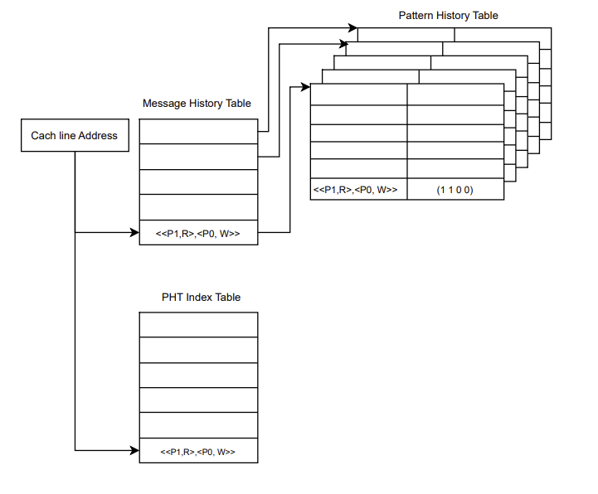
LRU Consumer Prediction Scheme
Reads:
Update MHT and PHT
Writes:
Update MHT
Access PHT using PIT to get prediction
Update PIT
Notes:
PRESTON ADD SCRIPT

Slide 24
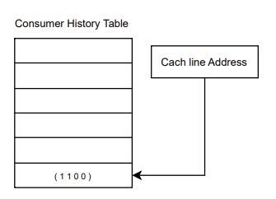
Overide Consumer Prediction Scheme
Adds a Consumer History Table (CHT)
Tracks current readers of most recent write
PHTable updates values by overriding them with CHT
Reads:
Update MHT and CHT
Writes:
Update MHT
Access PHT with MHR to get prediction
Update PIT
Update PHT with CHT using PIT
Clear CHT
Notes:
PRESTON ADD SCRIPT

Slide 25
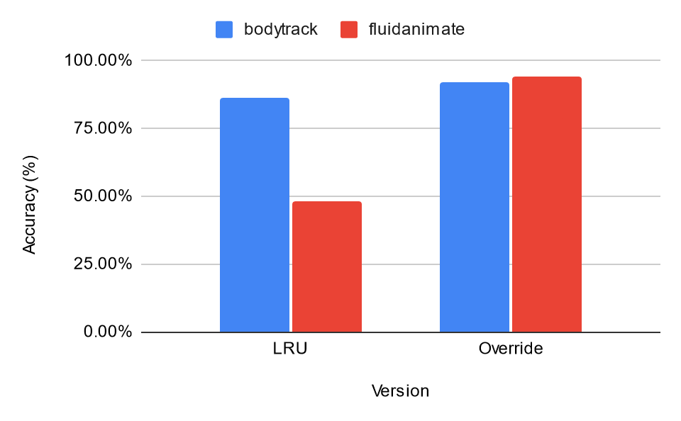
Consumer Prediction Results
MHR Depth = 3 ; One Bit/Processor Prediction
Notes:
We run our two consumer predictors on the two highlighted benchmarks from before with the most shared lines. We initially run our two consumer predictors with an MHR history depth of 3 and a one bit saturating counter per processor at the PHT. We note that we take a pessimistic approach to accuracy, meaning that for one singular prediction, our consumer predictor must predict the consumer state of all processors correctly, in our case 32 processors, to be considered as correct.

Slide 26
Consumer Prediction Results
LRU predictor performs worse than Override
MHR Depth = 3 ; One Bit/Processor Prediction
Notes:
We find that the Override predictor performs significantly better on both benchmarks than LRU since it is able to update quicker.

Slide 27
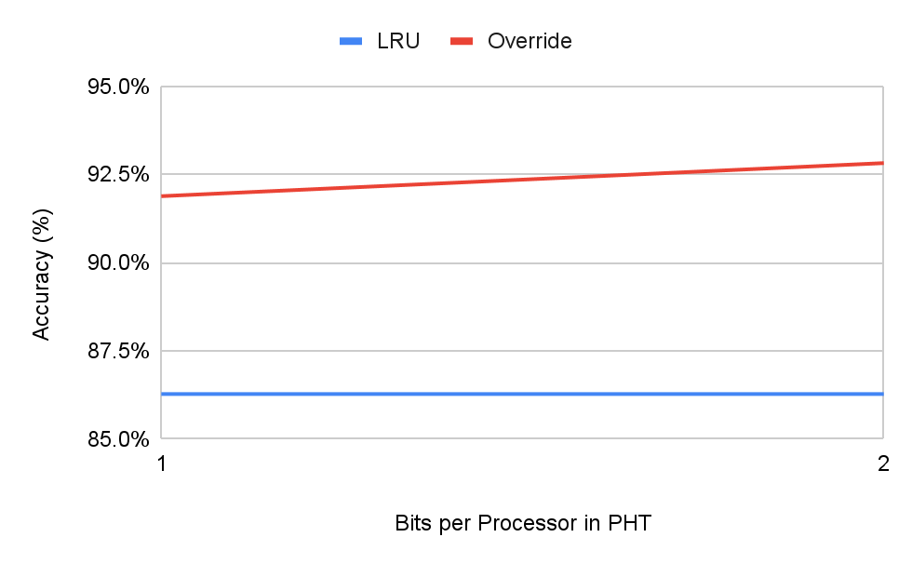
Consumer Prediction Bit Sensitivity
MHR Depth = 3
Notes:
We also perform a bit sensitivity analysis on our consumer predictors. This graph shows the bodytrack workload where we run on one bit and two bit saturating counters at the PHT per processor.

Slide 28
Consumer Prediction Bit Sensitivity
Increasing number of bits in saturating counter slightly increases performance at 2x memory
MHR Depth = 3
Notes:
We find that while we can slightly increase performance of both predictors, it is not worth the 2x memory cost. This trend is similar on the fluidanimate benchmark. Because of this, for future tests, we show only one bit predictors.

Slide 29
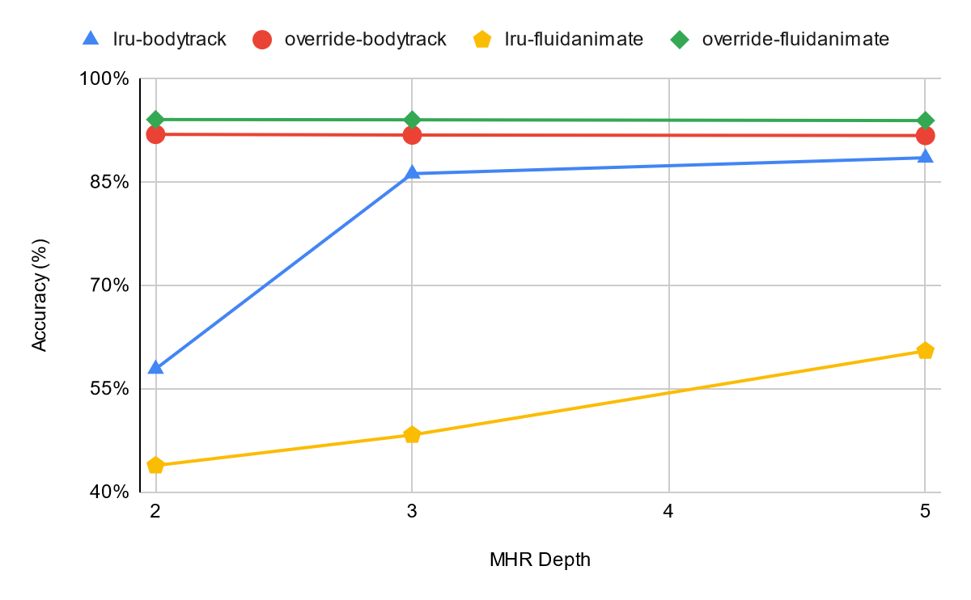
Consumer Prediction History Depth Sensitivity
One Bit/Processor Prediction
Notes:
We also perform sensitivity analysis on the depth of MHR entries for both predictors. This is the access history of a cache line, as seen from the home site.

Slide 30
Consumer Prediction Results
LRU performs better with more history
One Bit/Processor Prediction
Notes:
We find that the LRU performs better with more history of the past as shown by the yellow and blue lines.

Slide 31
Consumer Prediction Results
LRU performs better with more history
Override performs well with irrespective of history depth
One Bit/Processor Prediction
Notes:
In contrast, the override performs well irrespective of history depth with an average accuracy of 92% on both benchmarks.

Slide 32
Research Objectives
Analyze a Modern Benchmark Suite Shared Memory Access Pattern
PARSEC Benchmark Suite [5]
Evaluate homesite consumer prediction schemes benchmark suite
Notes:
Now we have demonstrated and evaluated two homesite consumer prediction schemes.

Slide 33
Conclusion
Statistical analysis of coherence prediction opportunity on the PARSEC 3.0 benchmark suite
Little opportunity on tested benchmarks with little history, making the task difficult.
Proposed two consumer predictors at the homesite
LRU Consumer Prediction
Override Consumer Prediction
Notes:
In conclusion, we find that from our statistical analysis of PARSEC 3.0, there is limited opportunity with little history, making the prediction task difficult, with not much performance gains. We then move on and propose two consumer predictors at the home site: the LRU and Override predictors. The Override predictor performs better than the LRU in all cases that we tested, with an average accuracy of 92% on all runs of bodytrack and fluidanimate.

Slide 34
Future Work
Get all PARSEC benchmarks working and run longer experiments
Examine other parallel, shared memory workloads which may have more consumers in a consumer-producer scheme
Look at database and datacenter workloads
Analyze memory footprint of Consumer Predictors
Evaluate the Override Consumer Predictor on a cycle-accurate simulator to get speedup
Look into Homesite Request Prediction
Notes:
In the future, we hope to fix the other three PARSEC benchmarks, and run longer experiments with more cores. Since PARSEC may not be representative of all benchmarks, we hope to also examine other parallel benchmarks and see if there is a niche where consumer prediction may be useful still. In addition, we hope to evaluate the proposed consumer predator’s memory footprint and the possible speedup that it can achieve. Lastly, there is still more work that can be done in coherence prediction, primarily homesite request prediction, that we did not touch upon in our study.

Slide 35
Thank You!
Notes:
Thank you!

Slide 36
Thank You!
Any Questions?
Notes:
Any questions?

Slide 37
Just kidding, its recorded :)
Notes:
Just kidding :)

Slide 38
References
[1] Shubhendu S. Mukherjee and Mark D. Hill. “Using Prediction to Accelerate Coherence Protocols”. In: Proceedings of the 25th Annual International Symposium on Computer Architecture. ISCA ’98. Barcelona, Spain: IEEE Computer Society, 1998, pp. 179–190. isbn: 0818684917. doi: 10.1145/279358.279386. url: https://doi.org/10.1145/279358.279386.
[2] An-Chow Lai and B. Falsafi. “Memory sharing predictor: the key to a speculative coherent DSM”. In: Proceedings of the 26th International Symposium on Computer Architecture (Cat. No.99CB36367). Proceedings of the 26th International Symposium on Computer Architecture (Cat. No.99CB36367). ISSN: 1063-6897. May 1999, pp. 172–183. doi: 10.1109/ISCA.1999.765949. url: https://ieeexplore.ieee.org/document/765949
[3] S. Kaxiras and C. Young. “Coherence communication prediction in shared-memory multiprocessors”. In: Proceedings Sixth International Symposium on High-Performance Computer Architecture. HPCA-6 (Cat. No.PR00550). HPCA: 6th International Symposium on High-Performance Computer Architecture. Touluse, France: IEEE Comput. Soc, 1999, pp. 156–167. isbn: 978-0-7695-0550-3. doi: 10.1109/HPCA.2000.824347. url: http://ieeexplore.ieee.org/document/824347/.
[4] Sean Leventhal and Manoj Franklin. “Perceptron Based Consumer Prediction in Shared-Memory Multiprocessors”. In: 2006 International Conference on Computer Design. 2006 International Conference on Computer Design. ISSN: 1063-6404. Oct. 2006, pp. 148–154. doi: 10.1109/ICCD.2006.4380808. url: https://ieeexplore.ieee.org/abstract/document/4380808.
[5] Xusheng Zhan et al. “PARSEC3.0: A Multicore Benchmark Suite with Network Stacks and SPLASH-2X”. In: SIGARCH Comput. Archit. News 44.5 (Feb. 2017), pp. 1–16. issn: 0163-5964. doi: 10.1145/3053277.3053279. url: https://doi.org/10.1145/3053277.3053279.
Notes:
Here are all of our references.

